Slide 1
Just Culture in DevOps
Barriers in Implementation
Edgar Arroyo/Module 9/ February 22, 2025

Slide 2
What is “Just Culture”?
When accidents occur, the response should be “just” — focusing on learning and improvement rather than punishment.
Key Principles
Shared accountability - Responsibility for software is shared across teams.
Psychological safety - Encourages open communication and learning from failures, instead of placing blame.
Transparency - Promotes clear and honest communication between developers, operations, and leadership.

Slide 3
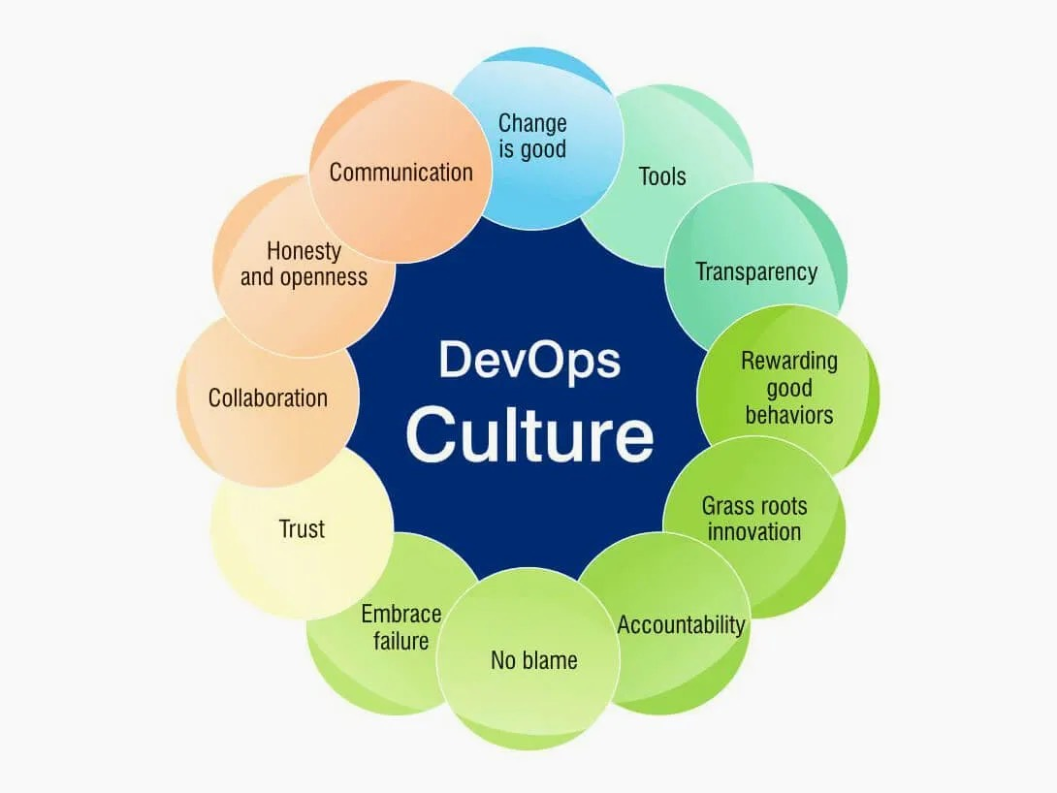
DevOps Culture, Aditi Shembekar

Slide 4
Benefits of a “Just Culture”
Encourages Innovation - Teams feel empowered to share ideas without fear, driving creativity.
Strengthens Trust & Collaboration - Open communication leads to better teamwork and higher quality products.
Promotes Continuous Learning - Accidents become learning opportunities, fostering growth and continuous improvement.

Slide 5
Several barriers can hinder the development of a “Just Culture”…

Slide 6
Barrier: Fear of Punishment
Team members may feel hesitant to report errors if they fear disciplinary action.
This can lead to undetected issues and decreased team morale.
How to overcome it:
Foster an environment where mistakes are seen as learning opportunities.
Shift the focus from punishment for mistakes, to improvements from them.

Slide 7
Barrier: Resistance to Change
“If the benefits of change aren’t clearly articulated and understood, it can be difficult to drive acceptance and willingness to put in the work” (Hall)
Teams may resist change if the benefits are not clearly communicated.
Established blame cultures make shifting to a “Just Culture” difficult.
How to overcome it:
Demonstrate complete transparency and emphasize the benefit.
Managers and senior staff should lead by example by embracing the “Just Culture” key principles.

Slide 8
Barrier: Gaps in Communication
Lack of transparency from leadership creates uncertainty and mistrust.
Without trust, teams may feel unable to have open discussion, leaving potential issues undetected.
How to overcome it:
Leaders should share updates on all aspects of the business.
Leaders should use effective communication tools, such as regular meetings and collaboration tools (Slack, Teams, etc.)
Expectations should be clearly set and explained, ensuring responsibilities and goals are well-defined.

Slide 9
Closing Thoughts…
“Just Culture” encourages innovation, strengthens trust and collaboration, and promotes continuous learning.
Barriers must be overcome to fully implement a “Just Culture”.
Barriers can be overcome with leadership support, clear and transparent communication, and shifting from blame cultures to one of continuous learning.

Slide 10
Sources
“Benefits of Embracing the Devops Culture.” CTO.Ai Blog | Cloud Native DevOps Workflows for Development Teams in Slack, 13 Sept. 2023, cto.ai/blog/benefits-of-embracing-the-devops-culture/.
Bhuyan, Aditya. “Bridging the Silos: Overcoming Challenges in Building a Devops Culture.” DEV Community, 29 Apr. 2024, dev.to/adityapratapbh1/bridging-the-silos-overcoming-challenges-in-building-a-devops-culture-5eg4.
Hall, Tom. “Devops Culture.” Atlassian, www.atlassian.com/devops/what-is-devops/devops-culture. Accessed 23 Feb. 2025.
Shembekar, Aditi. “DevOps Culture - the Complete Details [Top 5 Benefits].” Openxcell, 1 Aug. 2024, www.openxcell.com/blog/devops-culture/.
Vakkuri, Katariina. “The Power of Psychological Safety in Building Devops Culture.” Polar Squad, 3 Oct. 2024, polarsquad.com/blog/power-of-psychological-safety.

